Slide 1
Web Introduction
ISW-512

Slide 2
Agenda
Understand how the Web works
Related Components
HTML Dynamic vs Static
Client - Server Topology

Slide 3
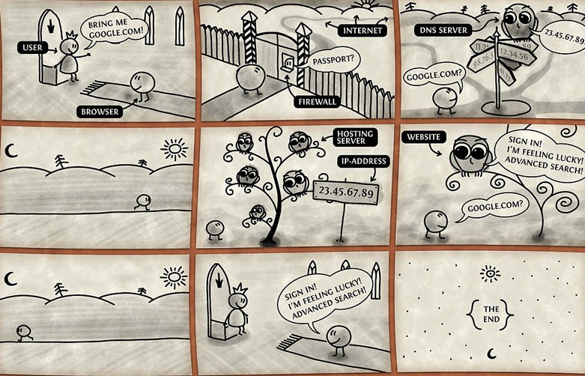
Understand how the Web Works

Slide 4
Related components
Network → That’s why they call it InterNET
DNS → Turn domain names into IPs
Web Server → Where the site is hosted
Firewall → Filtering what’s go in and out
IP → Unique identifier of the host
Hosting → Service to store the files of a site
Domain → The unique name
HTTP → Network protocol used by the Web
Request → Network package sent to a server using HTTP
Response → Network package return by the server using HTTP
URL → http://www.example.com/
URI → /test.html

Slide 5
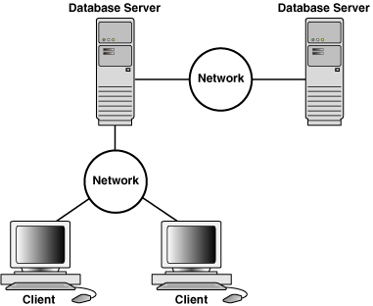
Client - Server Topology
This is how we currently know it:

Slide 6

Client - Server Topology
This is how it looks in Web:

Slide 7
Benefits of Web vs Desktop
Availability
Distribution
One single place for updates/upgrades

Slide 8
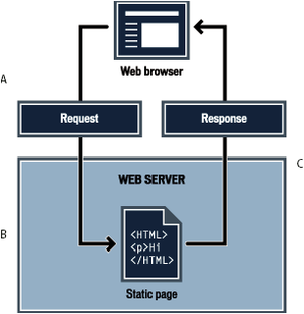
Static HTML

Slide 9
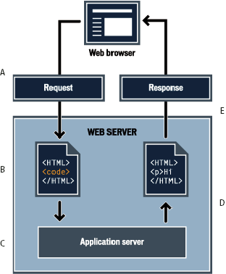
Dynamic HTML

Slide 10
HTML Static vs
HTML Dynamic
Features limited to client resources.
Need developer intervention to change the content
Response is always HTML no matter what.
Is/Can be cached by the browser
You can add some dynamic features with Javascript and HTML5
Tons of libraries to everything we know that can be done in Web.
Content can vary based on a database change, another site, the date, no need for developer intervention
Response could be anything that the browser can show for the same URL. Its generated dynamically.
You have to control when to expire or cache the response

